Slide 1
MedHelper
A Smart Tool to Research and Track Medications
ANANTH DANDIBHOTLA
GRADE: 10
METHACTON HIGH SCHOOL, EAGLEVILLE, PA

Slide 2
Problem Question
Can technology improve prescription compliance?
Hypothesis
Prescription compliance can be improved upon using
smartphones and cloud technologies.

Slide 3
Materials Procedure
Android based Smartphone
(Version 4.2 JellyBean or Higher)
Desktop or laptop
with a 2.5 GHz Intel Core i7,
16GB 133 MHz DDR3 RAM
IDE – Android Studio 1.5
Java SE development kit 8 (JDK)
Test Medications
Internet Access
Zxing library
Install Android SDK for App development
Review DailyMed website’s requirements, URL specifications
Gather a few sample medications for testing. Make sure use the same set to get repeatable results during the App development.
Get familiar with data structures, Web services, JSON and figure out how to parse incoming data.
Research on the web to find an api that helps scan UPC barcode and provides the data.
Incorporate Toast messages to let user know when an action is complete.
Add features (Search screen, Scan screen, My Meds list, Meds Taken list, Email notifications ) to achieve the goals of the project.
Setup Amazon Web Services. Configure Apache, TomCat, MySQL
Create MedHelper database in MySQL

Slide 4
Motivation
$ 100 - 289
Billion/Year
In Rx
Non-Compliance
Costs
Failing to comply with medication prescriptions costs
U.S. anywhere between $100 to $289 billion a year.
Up to 50 % of medications aren't taken as prescribed.
Medication noncompliance creates major headaches for
patients and doctors.
According to the study, failure to follow prescriptions
causes some 125,000 deaths a year and up to 10%
of all hospitalizations.
Source Notes: Annals of Internal Medicine

Slide 5
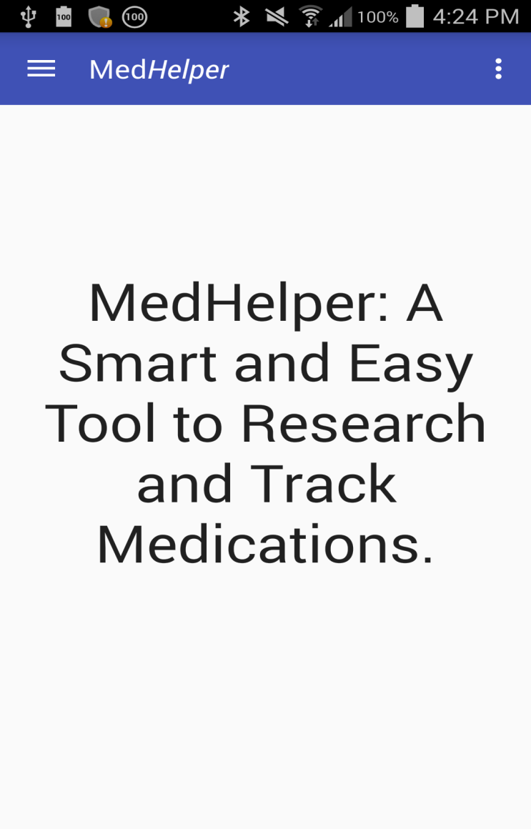
MedHelper Goal
My project’s goal is to develop an easy to use app by leveraging the power of smartphones.
The app will hopefully help medication users adhere to prescription compliance with the use of:
A My Medications List - Allow users to add their frequently taken medications
Medication History - Record when users take the medications
Email Notification - Email medication usage notifications to assigned care takers
Cloud Storage– Safe and secure data storage in the Cloud
5

Slide 6
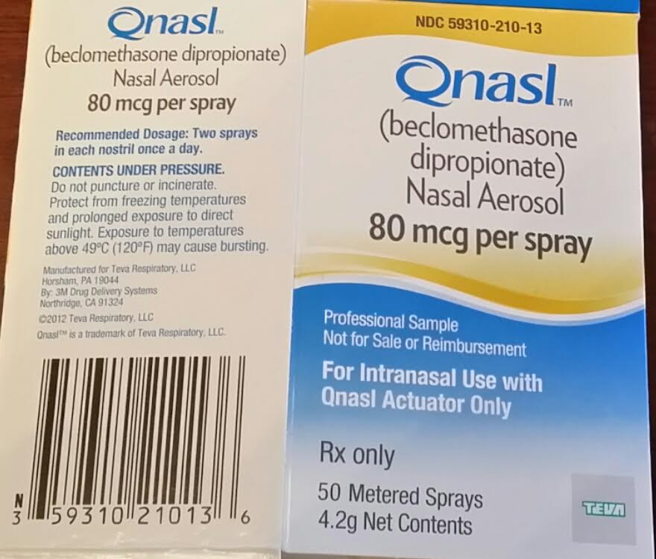
Background Research Conducted To Understand NDC & UPC formats
A lot of research was done to understand the unique identifiers assigned to drugs.
Researched about National Drug Code (NDC) and Universal Product Code (UPC).
Discovered format differences within NDC.
Implemented functionality to extract NDC from UPC.
Finalized a reliable source for drug data by Experimenting with FDA’s (openFDA) web services and DailyMed web services (contains drug listings as submitted to the Food and Drug Administration (FDA).
DailyMed was chosen for its reliability when retrieving data and ease of use when parsing it.
NDC - National Drug Code
Assigned to all U.S. medications
10 Digit code with 3 segments
UPC - Universal Product Code
12 digits
Uniquely assigned to each
trade item
Notes:
DailyMed Announcements
Posted: December 1, 2015 DailyMed changing to HTTPS DailyMed is changing its base URLs from HTTP to HTTPS. The new base URL for the web application is: https://dailymed.nlm.nih.gov/ The new base URL for the web service is: https://dailymed.nlm.nih.gov/dailymed/services/ If you are using our web services with HTTP, please update your code to use HTTPS by January 31, 2016. After that date, HTTP access will be disabled.

Slide 7

Background Research Conducted To Understand Cloud Technologies and Amazon Web Services
Researched about Amazon Web Services by reading various online documentation on Amazon.
Researched how to isolate database server from application server and proxy server.
Identified the configuration settings to setup the integration between proxy, app, and database server.
Learned about ways to identify various problems, how to read log files, and searching the error code on Google.
Researched REST services and code to retrieve data
JSON structure was widely used by websites to send data, the same format was used in the project

Slide 8


Sample Drugs Tested Using FDA (openFDA) and DailyMed
Drug Name | FDA’s openFDA product_ndc search | DailyMed | Drug Search Method: Scan UPC | Drug Search Method: Manual NDC input
MethylPREDNISolone NDC: 0603-4593-15 Control Sample
SUDAFED PE NDC: 50580-679-25
Mucinex DM NDC: 63824-072-35
Zyrtec-D NDC:50580-728-12
CVS COLD RELIEF NDC: 59779-873-60
Therafluocinonide NDC: 0093-0264-92
Tylenol NDC:50580-404-08
Theraflu NDC:0067-6426-06
Delsym NDC:63824-171-63
Children’s Mucinex NDC:63824-256-12
Notes:
DailyMed Announcements
Posted: December 1, 2015 DailyMed changing to HTTPS DailyMed is changing its base URLs from HTTP to HTTPS. The new base URL for the web application is: https://dailymed.nlm.nih.gov/ The new base URL for the web service is: https://dailymed.nlm.nih.gov/dailymed/services/ If you are using our web services with HTTP, please update your code to use HTTPS by January 31, 2016. After that date, HTTP access will be disabled.

Slide 9
Programming Concepts Used
This is an Android based app
App uses an Android swipe navigation bar
Each app screen extends a Fragment (android class)
Each app screen has its own class and layout file
Helper classes were created to parse URL data, to get, parse, and store medication data
Used DailyMed’s RESTful APIs to get drug data
Drug data was provided in JSON and XML format
Data was parsed using Java classes
JSONObject, JSONArray were used
Relational Database (mySQL) is used to store data
Tomcat 8 is run on application server.
REST is used to retrieve data

Slide 10
Technologies Used In MedHelper
UI
User Interface is an Android based smartphone app
Android development kit, Android Studio, third party scanning library.
Security
Uses Google’s Sign-in technology to validate user
Google authenticates the user and provides user credentials
Cloud
Leverages Amazon cloud capabilities to store and retrieve data
Amazon EC-2 instance running Linux is used. An Apache server acts as a proxy. The instance runs Tomcat to handle the application side.
Database
Amazon RDS is used, specifically a mySQL database. This is where the data is stored.
Data
Source
DailyMed’s REST APIs are used to retrieve drug name and details in real-time
Data is secured during transit due to https. Get/Post tested using google chrome extension
Notes:
DailyMed’s REST APIs are used to retrieve drug name and details in real-time
Data is secured during transit due to https. Get/Post tested using google chrome extension

Slide 11

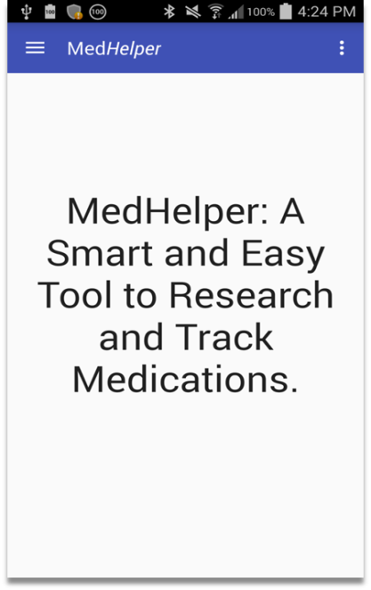


MedHelper Data Flow Diagram/Flow Chart
Google Play Services
Proxy
Apache
Web Server
Tomcat
Application
Server
MedHelper
REST
Application
RDS
MedHelper
Database
4
5
3
7
6
1
2
8
Amazon EC2
Relational Database Service (RDS) is mySQL
11
9
https request
REST API
10
https response
Data received in JSON and XML

Slide 12
Sample Pseudo-Code
Input Medication{
User inputs NDC code in the textbox;
User scans a barcode;
getNDCfromUPC{
//user scans a barcode
Use Zxing library to get text from UPC barcode;
Perform barcode to ndc conversion();
}
// Call the DailyMed's API to get SPL_ID
Call DailyMed{
Use the NDC code to call DailyMed Api
"https://dailymed.nlm.nih.gov/dailymed/services/v1/ndc/"+text+"/spls.xml"
Asynchronously Get Data;
This returns a string of JSON Data;
DailyMed returns drug name and spl_id;
//Call DailyMed's API to get drug details
Use the SPL_ID to call DailyMed's API;
https://dailymed.nlm.nih.gov/dailymed/services/v2/spls/"+s+"/packaging.json""
DailyMed returns drug details;
Asynchronously Get Data;
This returns a string of JSON Data;
DailyMed returns drug name and spl_id;
ParseDailyMedData();
}
}
ParseDailyMedData (){
//Create java JSON object. Run through the data and store what is needed.
// Code to parse data
try {
JSONObject jsonObject = new JSONObject(packagingData);
JSONObject dataObject = jsonObject.getJSONObject("data");
JSONArray productArray = dataObject.getJSONArray("products");
JSONObject productObject = productArray.getJSONObject(0);
……..
Medication.searchList.add(new Medication(name,s,ndc));
} catch (JSONException e) {
e.printStackTrace();
}
}

Slide 13
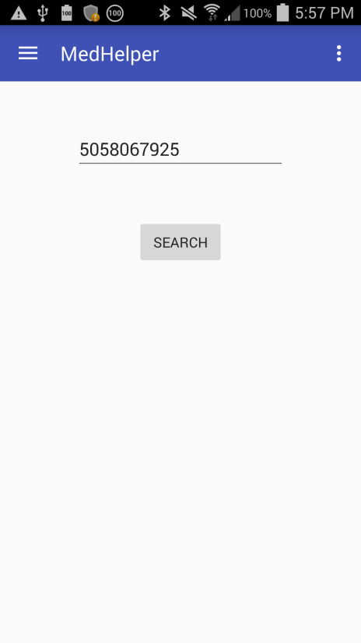
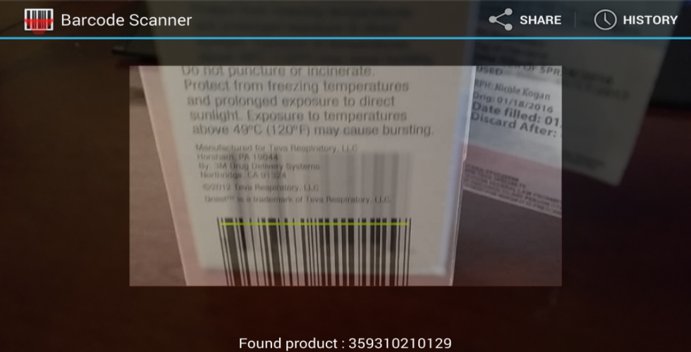
Input Search & Scan Methods
NDC code entered
Send NDC
(Make Web Service calls)
OR
Parse UPC to NDC
Send NDC to DailyMed
(Make 2 Web Service calls)

Slide 14
App Makes Two Web Service Calls To DailyMed
First call is made to get SPL* Id
Make a second call to get drug information
using SPL Id
URL url = new URL(params[0]);
urlConnection = (HttpURLConnection) url.openConnection(); urlConnection.setRequestMethod("GET"); urlConnection.connect(); InputStream inputStream = urlConnection.getInputStream();
First Call is made
To get SPL Id of the drug
GetRawData theRawData = new GetRawData("https://dailymed.nlm.nih.gov/dailymed/services/v1/ndc/"+text+"/spls.xml");
*SPL – Structured Product Labeling
Second Call Is Made
theRawData.reset(); theRawData = new GetRawData("https://dailymed.nlm.nih.gov/dailymed/services/v2/spls/"+s+"/packaging.json"); String packagingData = "";
try { packagingData = theRawData.execute(); } catch (ExecutionException e) { e.printStackTrace(); } catch (InterruptedException e) { e.printStackTrace(); }
Get the details of the drug using the SPL Id
Code to handle if data could not be retrieved

Slide 15
DailyMed’s Response
First Call – Retrieving SPL ID from DailyMed
SPL Id
Drug Name
<spls><spl><setid>cad07288-08bc-4d51-96b2bbefdcdee18a</setid><spl_version>2</spl_version><published_date>October 13, 2015</published_date><title>SUDAFED PE PRESSURE PLUS PAIN PLUS COLD (ACETAMINOPHEN, DEXTROMETHORPHAN HYDROBROMIDE, GUAIFENESIN, AND PHENYLEPHRINE HYDROCHLORIDE) TABLET, FILM COATED [JOHNSON &amp;amp; JOHNSON CONSUMER INC., MCNEIL CONSUMER HEALTHCARE DIVISION]</title></spl></spls>
Active Ingredients
Drug Form
Manufacturer Name
returns {"data":{"spl_version":2,"products":[{"packaging":[{"ndc":"50580-679-25","package_descriptions":["2 in 1 CARTON","12 in 1 BLISTER PACK"]}],"active_ingredients":[{"strength":"325 mg","name":"Acetaminophen"},{"strength":"10 mg","name":"Dextromethorphan Hydrobromide"},{"strength":"100 mg","name":"Guaifenesin"},{"strength":"5 mg","name":"Phenylephrine Hydrochloride"}],"product_name_generic":"Acetaminophen, Dextromethorphan Hydrobromide, Guaifenesin, and Phenylephrine Hydrochloride","product_name":"Sudafed PE Pressure Plus Pain Plus Cold","product_code":"50580-679"}],"published_date":"Oct 13, 2015","title":"SUDAFED PE PRESSURE PLUS PAIN PLUS COLD (ACETAMINOPHEN, DEXTROMETHORPHAN HYDROBROMIDE, GUAIFENESIN, AND PHENYLEPHRINE HYDROCHLORIDE) TABLET, FILM COATED [JOHNSON & JOHNSON CONSUMER INC., MCNEIL CONSUMER HEALTHCARE DIVISION]","setid":"cad07288-08bc-4d51-96b2-bbefdcdee18a"},"metadata":{"db_published_date":"Feb 10, 2016 05:10:36PM EST","current_url":"https://dailymed.nlm.nih.gov/dailymed/services/v2/spls/cad07288-08bc-4d51-96b2-bbefdcdee18a/packaging.json"}}
Second Call – Daily Med using SPL ID to get Drug Details

Slide 16
Formatted JSON Data
Parsing JSON Data To Show In The App
{ "data":{ "spl_version":2, "products":[ { "packaging":[ { "ndc":"50580-679-25", "package_descriptions":[ "2 in 1 CARTON", "12 in 1 BLISTER PACK" ] } ], "active_ingredients":[ { "strength":"325 mg", "name":"Acetaminophen" }, { "strength":"10 mg", "name":"Dextromethorphan Hydrobromide" }, { "strength":"100 mg", "name":"Guaifenesin" }, { "strength":"5 mg", "name":"Phenylephrine Hydrochloride" } ], "product_name_generic":"Acetaminophen, Dextromethorphan Hydrobromide, Guaifenesin, and Phenylephrine Hydrochloride", "product_name":"Sudafed PE Pressure Plus Pain Plus Cold", "product_code":"50580-679" } ], "published_date":"Oct 13, 2015", "title":"SUDAFED PE PRESSURE PLUS PAIN PLUS COLD (ACETAMINOPHEN, DEXTROMETHORPHAN HYDROBROMIDE, GUAIFENESIN, AND PHENYLEPHRINE HYDROCHLORIDE) TABLET, FILM COATED [JOHNSON & JOHNSON CONSUMER INC., MCNEIL CONSUMER HEALTHCARE DIVISION]", "setid":"cad07288-08bc-4d51-96b2-bbefdcdee18a" }, "metadata":{ "db_published_date":"Feb 10, 2016 05:10:36PM EST", "current_url":"https://dailymed.nlm.nih.gov/dailymed/services/v2/spls/cad07288-08bc-4d51-96b2-bbefdcdee18a/packaging.json" } }
try { JSONObject jsonObject = new JSONObject(packagingData); JSONObject dataObject = jsonObject.getJSONObject("data"); JSONArray productArray = dataObject.getJSONArray("products"); JSONObject productObject = productArray.getJSONObject(0); JSONArray packagingArray = productObject.getJSONArray("packaging"); JSONArray ingredientsArray = productObject.getJSONArray("active_ingredients"); JSONObject packagingObject = packagingArray.getJSONObject(0); JSONObject ingredientsObject = ingredientsArray.getJSONObject(0); name = productObject.getString("product_name"); Medication.searchList.add(new Medication(name,s,ndc)); // String ndc = packagingObject.getString("ndc");
Log.v("JSON OBJECT", jsonObject.toString()); Log.v("JSON OBJECT",productArray.toString()); Log.v("JSON OBJECT",productObject.toString()); Log.v("JSON OBJECT",packagingArray.toString()); Log.v("JSON OBJECT",ingredientsArray.toString()); Log.v("JSON OBJECT",packagingObject.toString()); Log.v("JSON OBJECT",ingredientsObject.toString()); Log.v("NAME",name); // Log.v("NDC",ndc+"<----- NDC"); } catch (JSONException e) { e.printStackTrace(); }

Slide 17
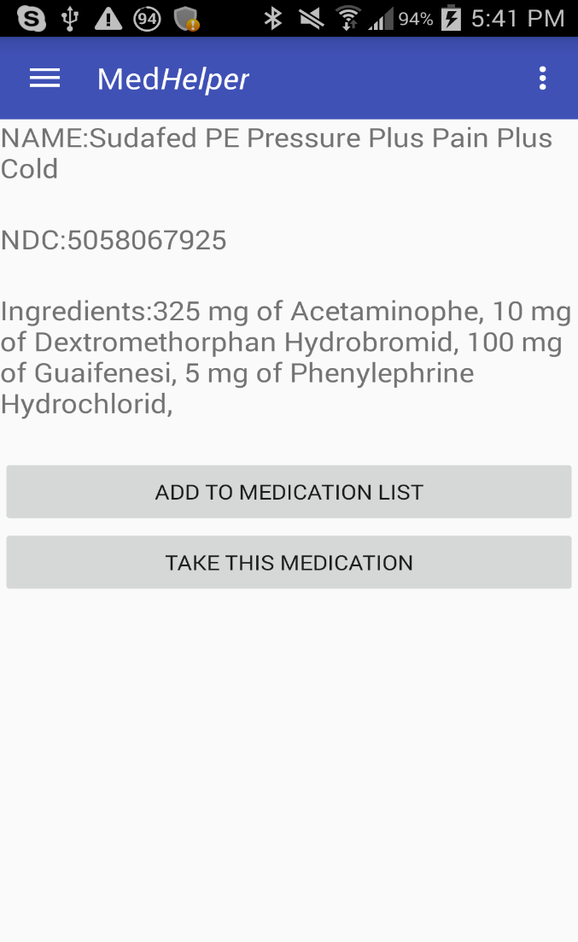
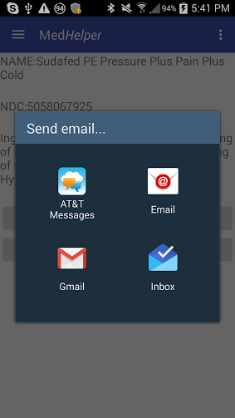
Display Search/Scan Result
Parsed data
Email option
User options
17

Slide 18
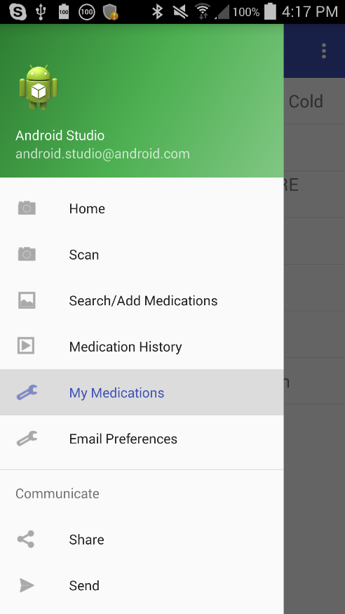
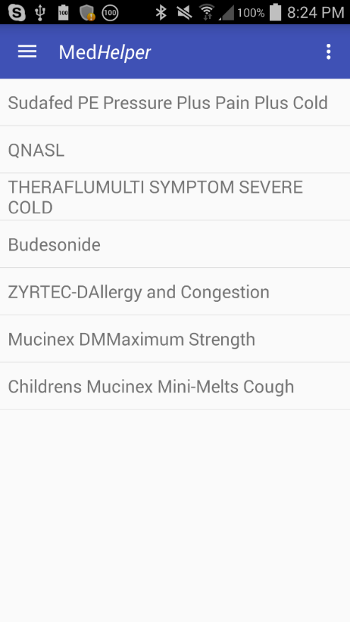
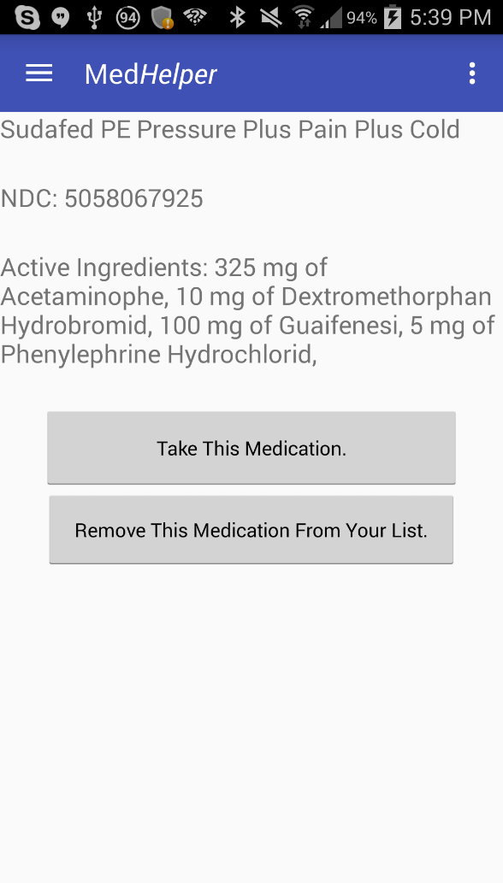
“My Medications” List
Drug Information
Drug Name
NDC
Ingredients
More Options to select
18

Slide 19
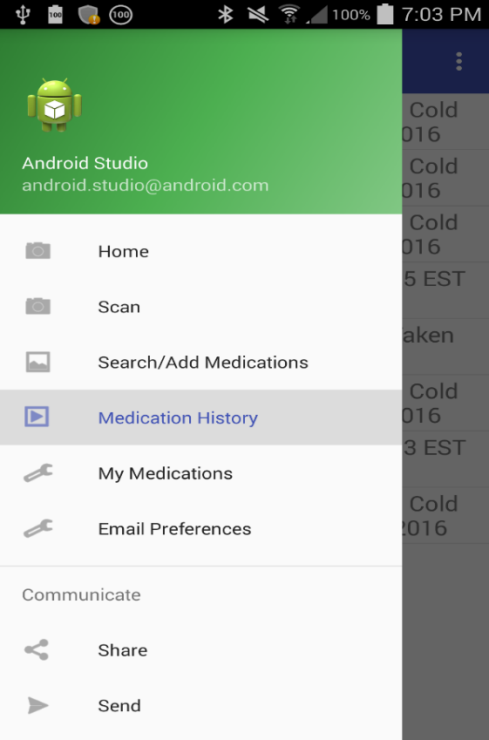
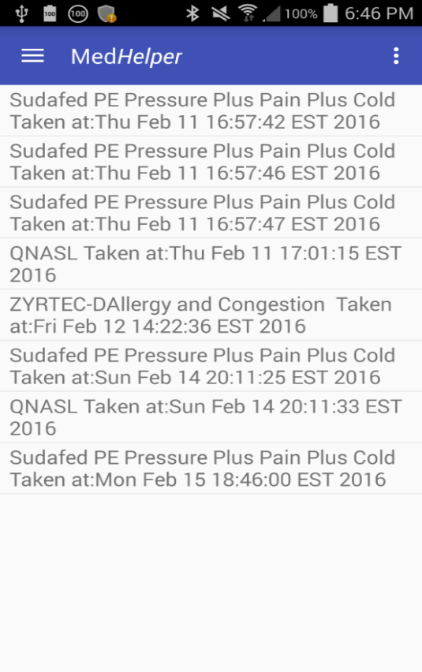
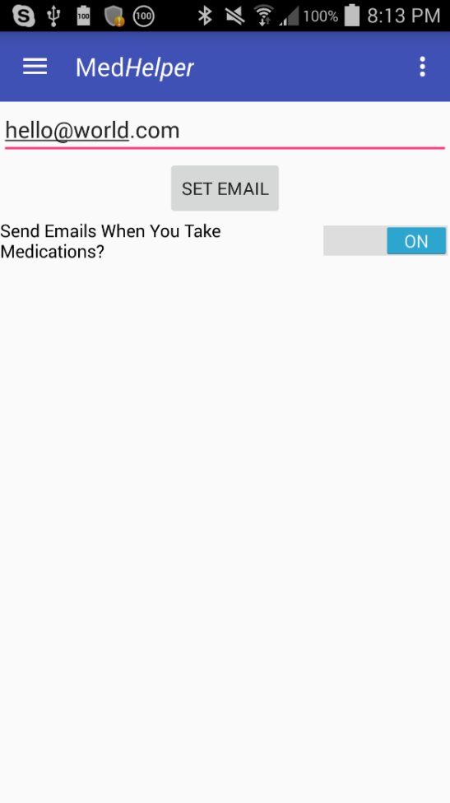
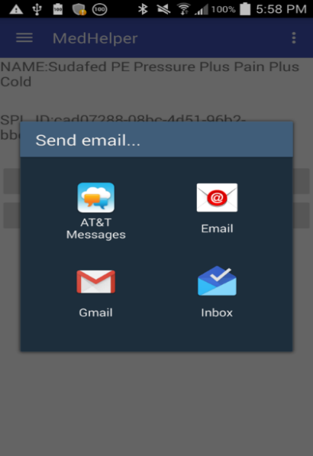
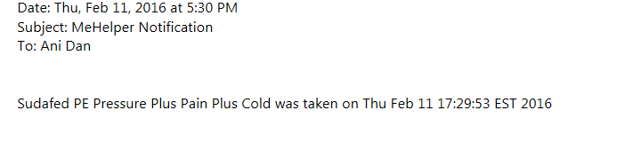
Setup Email Preferences
Medication History
If the email notification preference is on, MedHelper
notifies the care taker with the drug name, date, and
time the drug was taken.
Enter caretaker’s email
Toggles prompt to send email
19

Slide 20
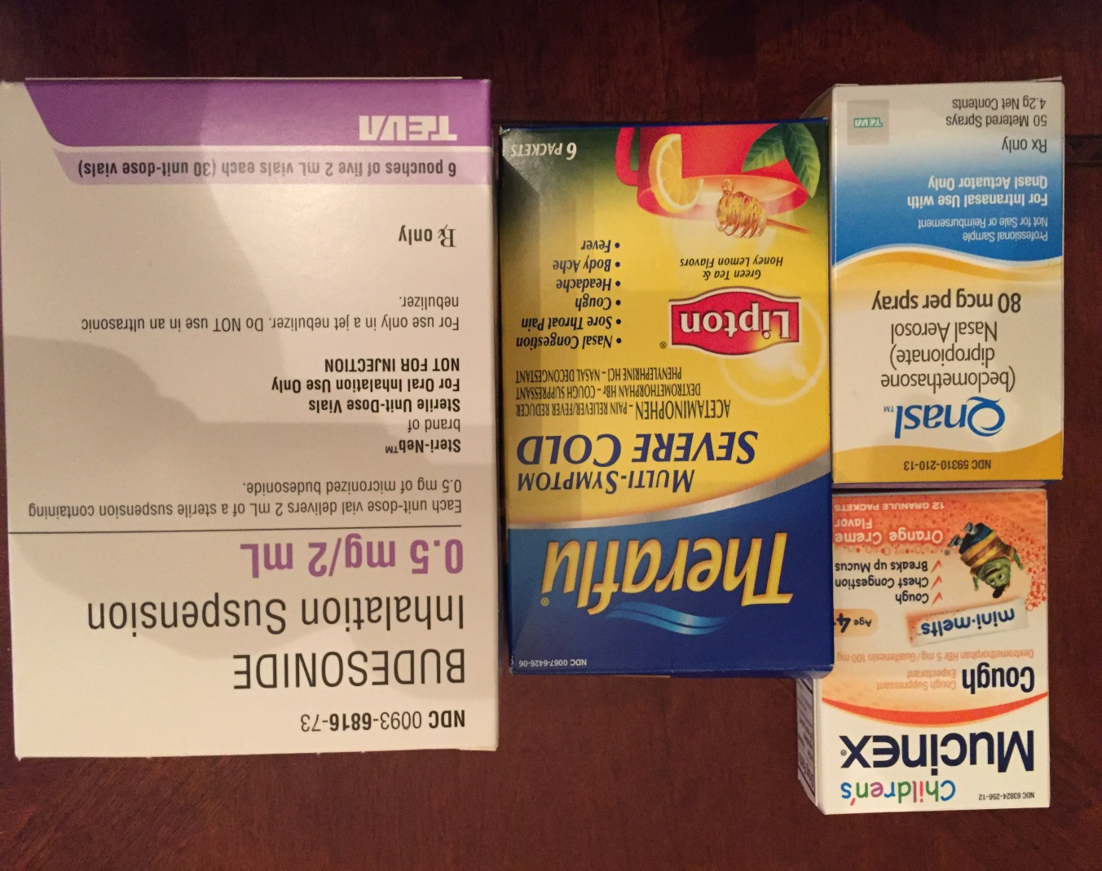
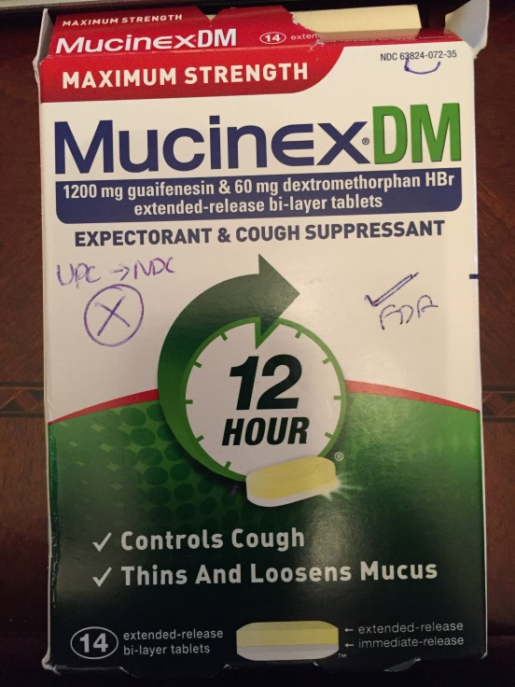
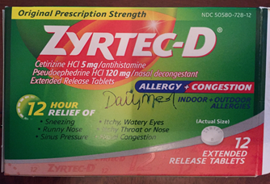
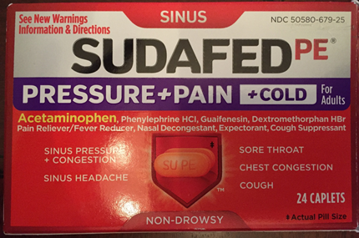
Sample Drugs Tested Using The Scan & Search Methods

Slide 21
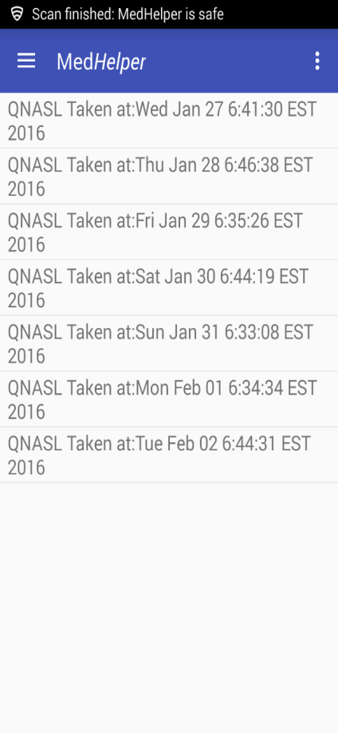
MedHelper Real World Applications
Sample Record of
my QNASL usage
My project’s rationale is to develop an easy to use app by leveraging the power of smartphones and the Cloud.
The app will help medication users, to adhere to prescription compliance with the below features:
My Medications - Allow users to add their frequently taken medications
Medication History - Record when users take the medications
Secure Login – User authentication feature through Google sign-in
Secure Data Transfer – Data is encrypted during transit using https
Secure Data Storage – MedHelper data is stored securely on Amazon Cloud
Email Notification - Email medication usage notifications to assigned care takers
Conclusion
In conclusion, the app met the project goals to keep prescription compliance.
The app is able to search/scan medications and retrieve information from online databases.
Data is securely stored on Amazon Cloud.
The app offers an option to notify a caretaker.
The app is able to keep track of the medication usage. I utilized the app to track my Qnasl prescription and to record it daily as shown here.
Prescription compliance is most likely to increase with MedHelper.

Slide 22
Challenges And Future Improvements
Project Challenges
Due to lack of standards related to drug packaging, the scanning only works when the NDC of the medication is embedded within the UPC code.
Working with openFDA has been a challenge as the data presented is complex and not directly related to the drug that was searched.
Converting UPC to NDC for non-prescription/generic drugs has been a challenge and was unable to test those drugs.
Adding accounts and a login screen to protect users data and make data transfer over different devices more efficient took a lot of time to research and implement.
Future Improvements
I want to add functionality to schedule automatic reminders.
I would like to setup app to app communication where a patient and a caretaker can exchange medication schedules. This could also tie into notifications as the app could notify if a patient has or hasn’t taken a specific medication.

Slide 23
Works Cited
"Amazon Elastic Compute Cloud Documentation." Amazon Web Services. Amazon Web Services, n.d. Web. 29 Mar. 2016. <http://aws.amazon.com/documentation/ec2/?icmpid=docs_menu_internal>.
"Apache Tomcat 8 Version 8.0.33 - Documentation Index." Apache Tomcat. Apache Software Foundation, 18 Mar. 2016. Web. 29 Mar. 2016. <http://tomcat.apache.org/tomcat-8.0-doc/index.html>.
"Application Development Support: Web Services." DailyMed. U.S. National Library of Medicine, n.d. Web. 2 Mar. 2016. <https://dailymed.nlm.nih.gov/dailymed/app-support-web-services.cfm>.
"APPLICATION DEVELOPMENT SUPPORT: Web Services: RESTful Resources." DailyMed. U.S. NATIONAL LIBRARY OF MEDICINE, n.d. Web. 15 Dec. 2015. <https://dailymed.nlm.nih.gov/dailymed/webservices-help/v1/ndc_spls_api.cfm>.
"AsyncTask." Android Developers. Google, n.d. Web. 2 Mar. 2016. <http://developer.android.com/reference/android/os/AsyncTask.html>.
Fung, Brian. "The $289 Billion Cost of Medication Noncompliance, and What to Do About It." The Atlantic. The Atlantic Monthly Group, 11 Sept. 2012. Web. 16 Feb. 2016. <http://www.theatlantic.com/health/archive/2012/09/the-289-billion-cost-of-medication-noncompliance-and-what-to-do-about-it/262222/>.
"Getting started with openFDA." openFDA. U.S. Food and Drug Administration, n.d. Web. 15 Dec. 2015. <https://open.fda.gov/api/reference/>.
"Introduction to Android." Android Developers. Google, n.d. Web. 15 Dec. 2015. <http://developer.android.com/guide/index.html>.
"Introduction to SQL." w3schools.com. Refsnes Data, n.d. Web. 29 Mar. 2016. <http://www.w3schools.com/sql/sql_intro.asp>.
"Java™ Platform, Standard Edition 8 API Specification." Oracle. 8th ed. Oracle, n.d. Web. 15 Dec. 2015. <https://docs.oracle.com/javase/8/docs/api/>.
"JSON Formatter & Validator." Curious Concept. Curious Concept, n.d. Web. 16 Feb. 2016. <https://jsonformatter.curiousconcept.com/>.
"National Drug Code Directory." U.S Food and Drug Administration. U.S. Department of Health and Human Services, 6 Jan. 2016. Web. 2 Mar. 2016. <http://www.fda.gov/Drugs/InformationOnDrugs/ucm142438.htm>.
"National Drug Codes." Drugs.com. Drugs.com, n.d. Web. 2 Mar. 2016. <http://www.drugs.com/ndc.html>.
Owen, Sean. "ZXing." ZXing. Github, n.d. Web. 15 Dec. 2015. <http://zxing.github.io/zxing/>.
"Package Index." Android Developers. Google, 11 Feb. 2016. Web. 16 Feb. 2016. <http://developer.android.com/reference/packages.html>.
"Start Integrating Google Sign-In into Your Android App." Google Developers. Google, n.d. Web. 29 Mar. 2016. <https://developers.google.com/identity/sign-in/android/start-integrating>.
"UPC Symbols." Global Trade Item Number. Bar Code Graphics, n.d. Web. 2 Mar. 2016. <http://www.gtin.info/upc/>.
Whitsel, Eric, et al. "Medication Survey Form." Collaborative Studies Coordinating Center. U of North Carolina at Chapel Hill, n.d. Web. 16 Feb. 2016. <http://www.cscc.unc.edu/carmri/ctrtrain/UNLICOMMCarotidMRIMedicationSurveyPresentation02152005.pdf>.

